Slide 1
OSS-Fuzz Driver Development
Ubuntu 24.04 VM

Slide 2
Requirements
Any modern Linux environment capable of running Docker and Python
(example: Ubuntu 24.04 running in VMWare Workstation or Virtualbox)
Docker images can consume significant disk space
Run docker-cleanup periodically to garbage-collect unused images.
Note: The Bash (Bourne Again SHell) is required for OSS-Fuzz challenges, and OSS-Fuzz specific commands unfortunately do not work in scripts. Bash is the default shell unless you change it.

Slide 3
Installation
Install Docker: (Only needed for local configurations)
$ curl -sSL https://get.docker.com/ | sh
$ dockerd-rootless-setuptool.sh install
Install OSS-Fuzz:
$ git clone https://github.com/google/oss-fuzz /opt/oss-fuzz
Pick a project:
$ cd /opt/oss-fuzz/projects/minizip/

Slide 4
Installation cont.
Examine the configuration needed for the project:
$ cat Dockerfile … apt-get update && apt-get install -y make cmake pkg-config libssl-dev:i386 zlib1g-dev:i386 libbz2-dev:i386 liblzma-dev:i386 libzstd-dev:i386 … git clone -b develop https://github.com/zlib-ng/minizip-ng /home/hacker/minizip-ng
Download the project outside of docker:
$ git clone -b develop https://github.com/zlib-ng/minizip-ng /home/hacker/minizip-ng

Slide 5
Installation cont.
Install VSCode or any other editor:
https://code.visualstudio.com/docs/setup/linux
Open folder containing fuzzing drivers, such as:
/home/hacker/minizip-ng/test/fuzz
Make a new fuzz driver
$ cp zip_fuzzer.c new_fuzzer.c

Slide 6
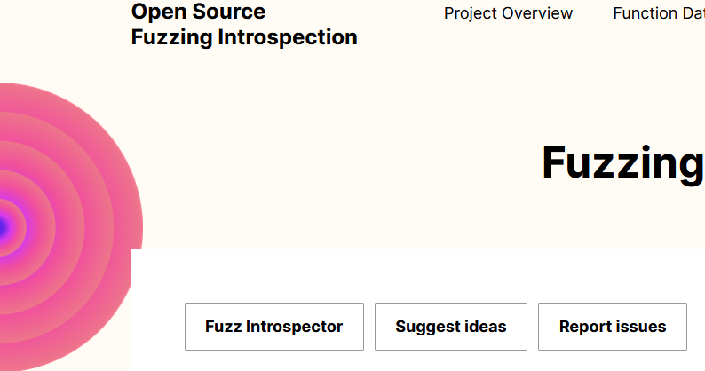
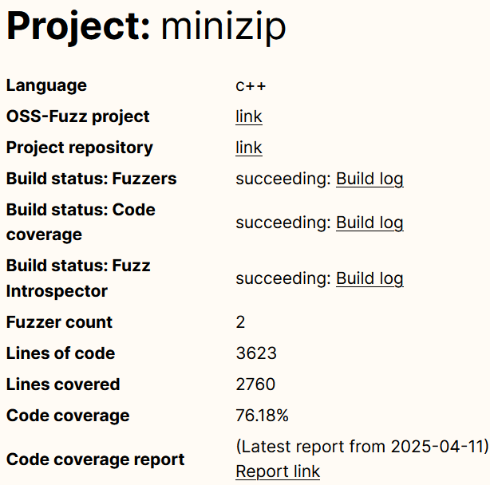
Online code details
Browse code online on:
https://introspector.oss-fuzz.com/projects-overview
Github repository links
Project statistics
Code coverage of existing fuzz drivers
Browse source code coverage reports

Slide 7
Integration
Start in the project folder (/opt/oss-fuzz/projects/minizip/)
edit build.sh and add any code references needed for new_fuzzer.c (not needed for minizip)
Option #1 (copy fuzz driver into docker image): edit Dockerfile and add:
COPY /home/hacker/minizip-ng/test/fuzz/new_fuzzer.c $SRC/minizip-ng/test/fuzz/
Option #2 (specify work folder in commands): edit Dockerfile and disable:
#RUN git clone -b develop https://github.com/zlib-ng/minizip-ng

Slide 8
Google’s OSS-Fuzz Documentation
From: https://google.github.io/oss-fuzz/getting-started/new-project-guide/#fuzzer-execution-environment
$ python3 infra/helper.py build_image $PROJECT_NAME
$ python3 infra/helper.py build_fuzzers --sanitizer <address/memory/undefined> $PROJECT_NAME
$ python3 infra/helper.py check_build $PROJECT_NAME
$ python3 infra/helper.py run_fuzzer --corpus-dir=<path-to-temp-corpus-dir> $PROJECT_NAME <fuzz_target>
$ python3 infra/helper.py build_fuzzers --sanitizer coverage $PROJECT_NAME
$ python3 infra/helper.py coverage $PROJECT_NAME --fuzz-target=<fuzz_target> --corpus-dir=<path-to-temp-corpus-dir>

Slide 9
Compile
All commands are assumed to be executed from this root folder:
$ cd /opt/oss-fuzz $ python3 infra/helper.py build_image minizip && \ python3 infra/helper.py build_fuzzers minizip \ /home/hacker/minizip-ng/
The new_fuzzer driver is NOT compiling! Let’s diagnose:
$ cd /opt/oss-fuzz/projects/minizip $ grep -rnwI . -e 'LLVMFuzzerTestOneInput' $ grep -rnwI . -e 'zip_fuzzer.c' $ grep -rnwI . -e 'zip_fuzzer'
./minizip-ng/CMakeLists.txt:976: configure_fuzz_test(zip_fuzzer) ./minizip-ng/CMakeLists.txt:980: install(TARGETS zip_fuzzer RUNTIME DESTINATION "${CMAKE_INSTALL_BINDIR}")

Slide 10
Fixing Compile
edit ./minizip-ng/CMakeLists.txt
@@ -953,10 +953,12 @@ configure_fuzz_test(zip_fuzzer) configure_fuzz_test(unzip_fuzzer) + configure_fuzz_test(new_fuzzer)
if(NOT SKIP_INSTALL_BINARIES AND NOT SKIP_INSTALL_ALL) install(TARGETS zip_fuzzer RUNTIME DESTINATION "${CMAKE_INSTALL_BINDIR}") install(TARGETS unzip_fuzzer RUNTIME DESTINATION "${CMAKE_INSTALL_BINDIR}") + install(TARGETS new_fuzzer RUNTIME DESTINATION "${CMAKE_INSTALL_BINDIR}") endif() endif()
edit Dockerfile (If Option #1)
COPY /home/hacker/minizip-ng/CMakeLists.txt $SRC/minizip-ng/

Slide 11
Verifying the Fix
$ python3 infra/helper.py build_fuzzers minizip \ /home/hacker/minizip-ng/
[ 73%] Built target minizip [ 78%] Building C object CMakeFiles/unzip_fuzzer.dir/test/fuzz/unzip_fuzzer.c.o [ 86%] Building C object CMakeFiles/new_fuzzer.dir/test/fuzz/new_fuzzer.c.o [ 86%] Building C object CMakeFiles/zip_fuzzer.dir/test/fuzz/zip_fuzzer.c.o [ 91%] Linking CXX executable zip_fuzzer [ 95%] Linking CXX executable unzip_fuzzer [100%] Linking CXX executable new_fuzzer [100%] Built target new_fuzzer [100%] Built target unzip_fuzzer [100%] Built target zip_fuzzer

Slide 12
Coverage report for new_fuzzer only
$ python3 infra/helper.py build_fuzzers minizip \ /home/hacker/minizip-ng && \ python3 infra/helper.py run_fuzzer \ --corpus-dir=/opt/oss-fuzz/build/corpus/minizip/new_fuzzer minizip \ new_fuzzer -- -max_total_time=30 && \ python3 infra/helper.py build_fuzzers --sanitizer coverage minizip \ /home/hacker/minizip-ng && \ python3 infra/helper.py coverage --fuzz-target=new_fuzzer \ --corpus-dir=/opt/oss-fuzz/build/corpus/minizip/new_fuzzer minizip

Slide 13
Coverage report for all fuzz drivers combined
$ python3 infra/helper.py build_fuzzers minizip \ /home/hacker/minizip-ng/ && \ python3 infra/helper.py run_fuzzer \ --corpus-dir=/opt/oss-fuzz/build/corpus/minizip/new_fuzzer minizip \ new_fuzzer -- -max_total_time=30 && \ python3 infra/helper.py run_fuzzer \ --corpus-dir=/opt/oss-fuzz/build/corpus/minizip/unzip_fuzzer minizip \ unzip_fuzzer -- -max_total_time=30 && \ python3 infra/helper.py run_fuzzer \ --corpus-dir=/opt/oss-fuzz/build/corpus/minizip/zip_fuzzer minizip \ zip_fuzzer -- -max_total_time=30 && \ python3 infra/helper.py build_fuzzers --sanitizer coverage minizip \ /home/hacker/minizip-ng/ && \ python3 infra/helper.py coverage --no-corpus-download minizip

Slide 14
Fuzz Introspector
Check for syntax options
$ python3 infra/helper.py introspector -h
Create report
$ python3 infra/helper.py introspector minizip \ /home/hacker/minizip-ng/
View in html
$ python3 -m http.server 8008 --directory /opt/oss-fuzz/build/out/minizip/introspector-report/inspector
(open Fuzz_report.html)

